Slide 1

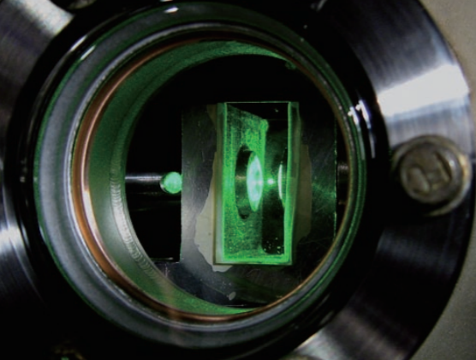
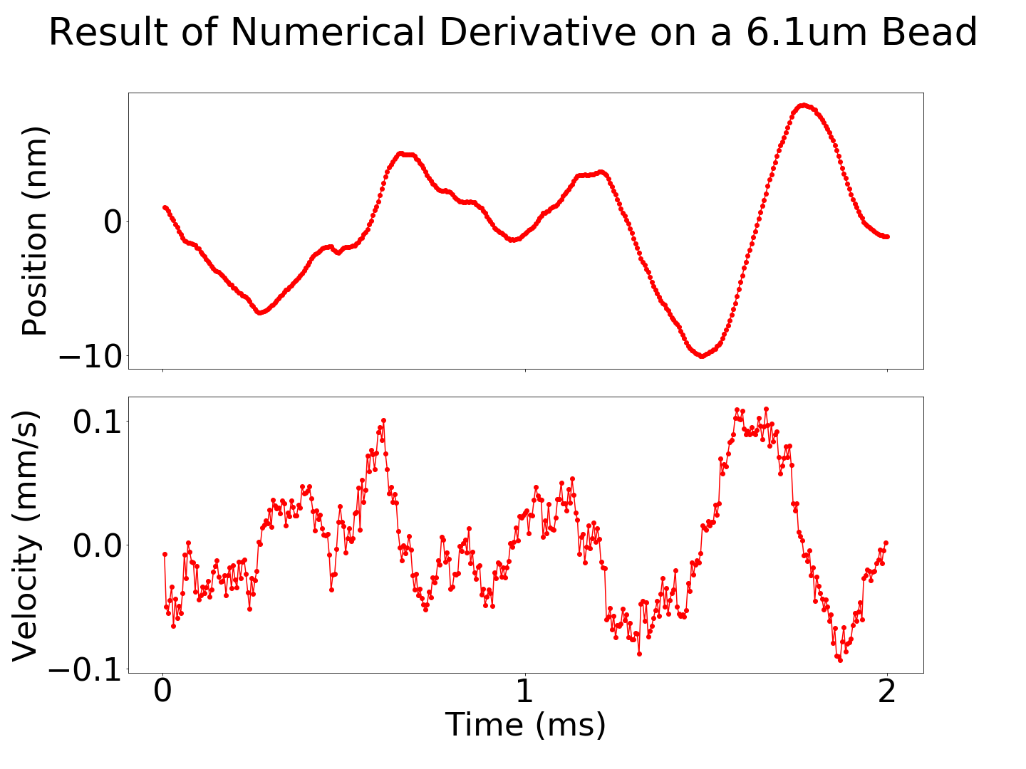
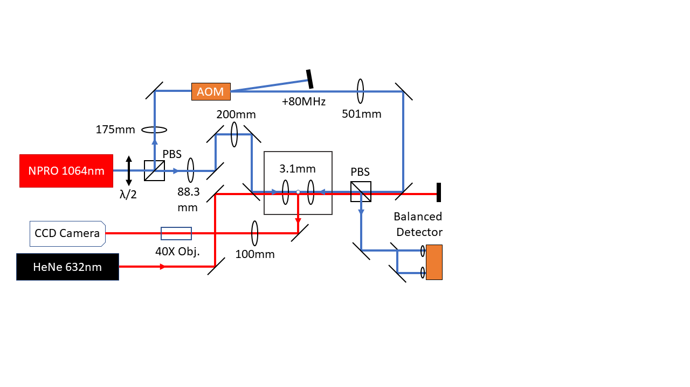
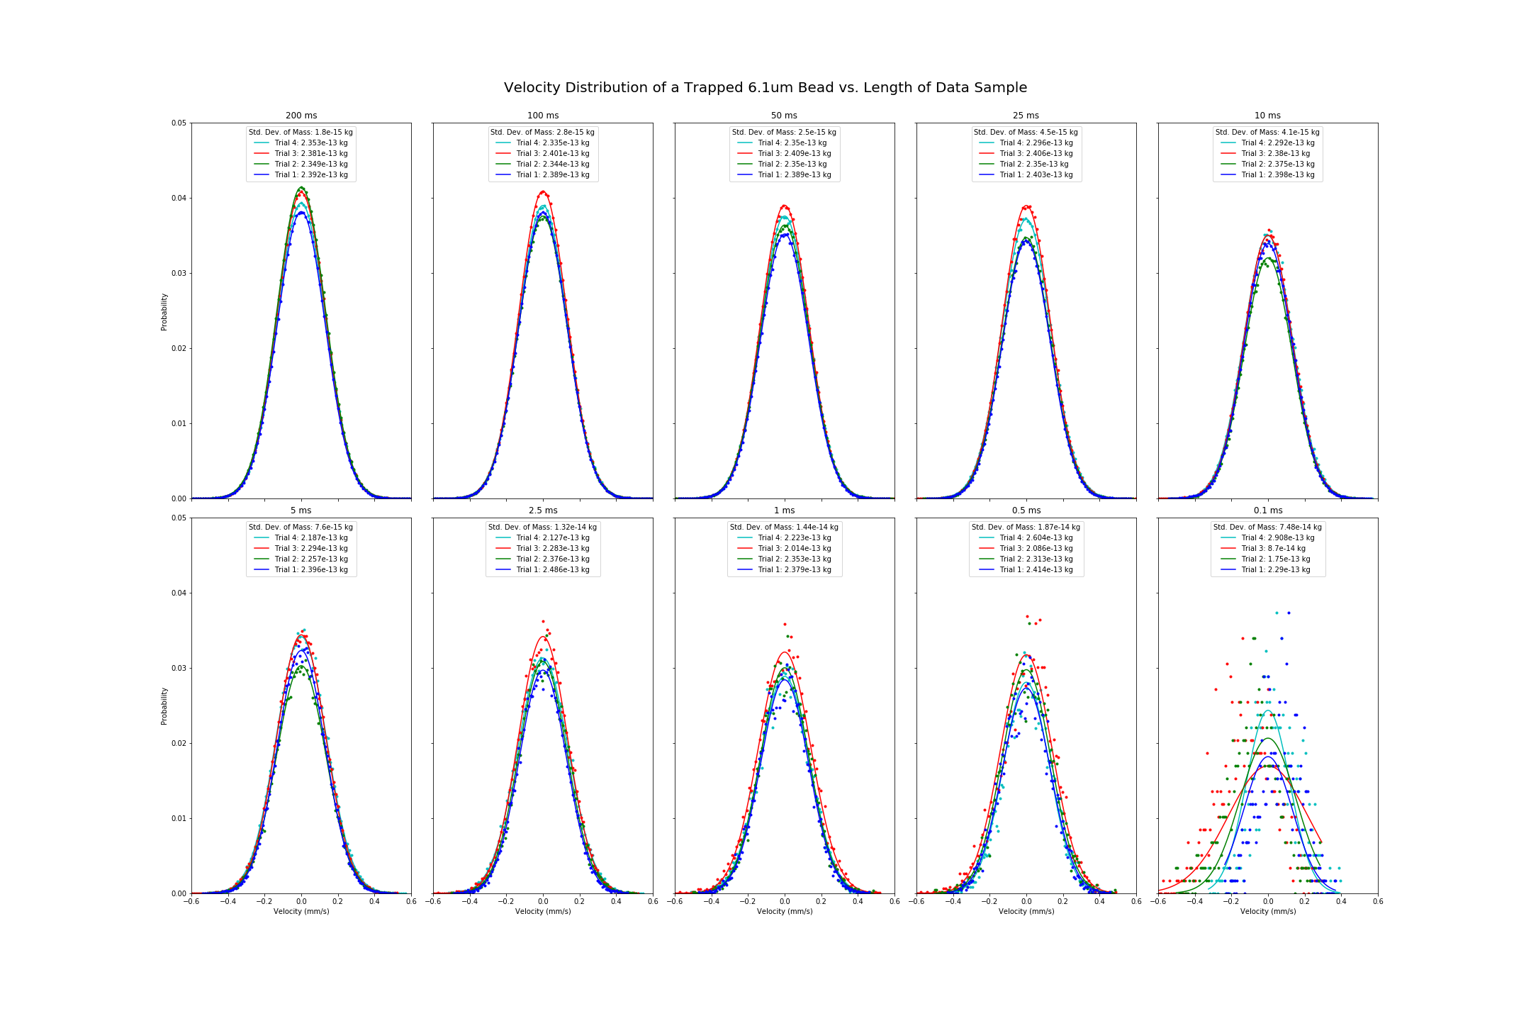
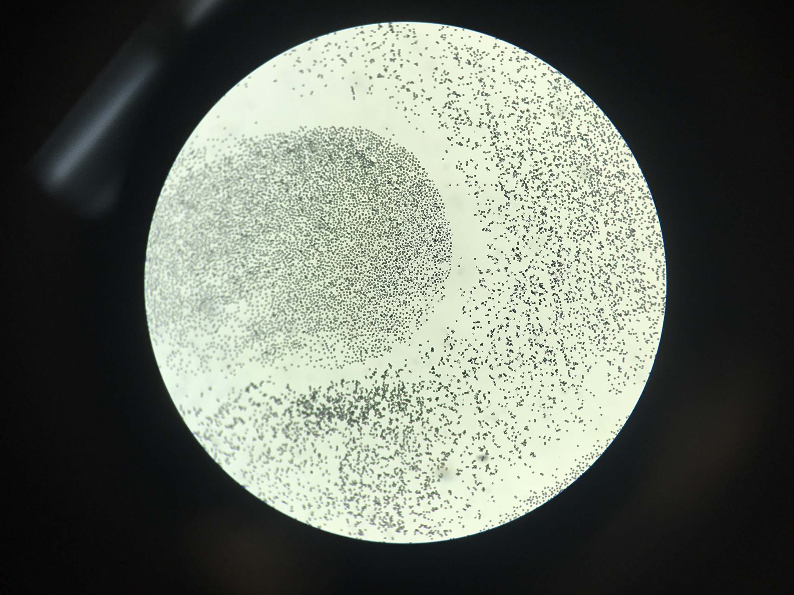

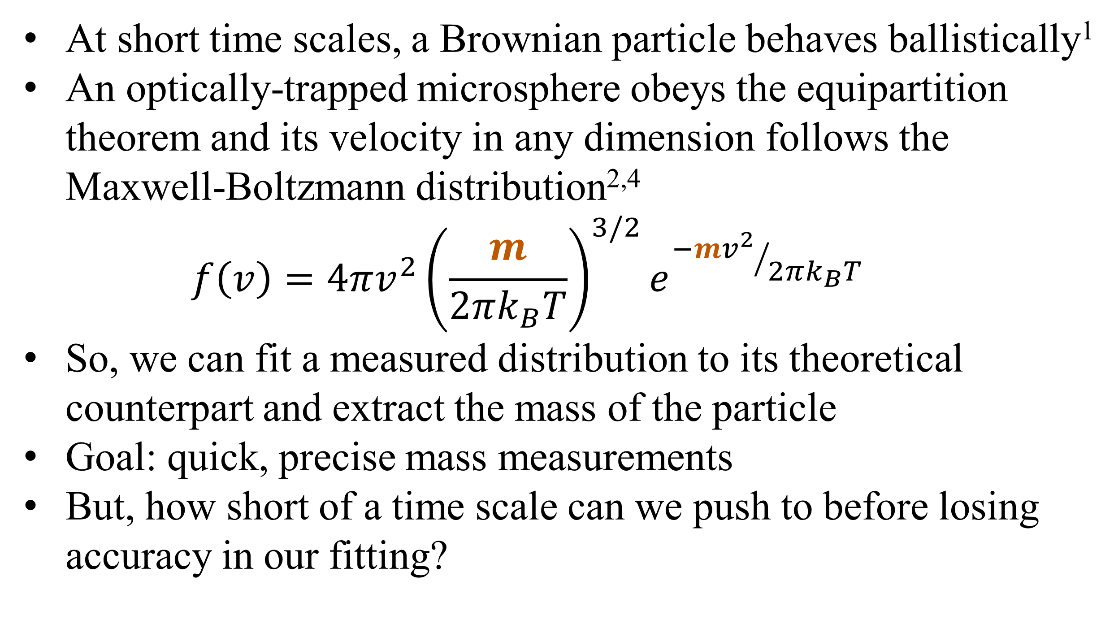
Using the instantaneous velocity of a Brownian particle in an optical tweezer to measure changes in mass
Gabriel H. Alvarez*, Julia E. Orenstein, Lichung Ha, Diney S. Ether Jr., Mark G. Raizen
University of Texas at Austin, Austin, TX (*Stanford University, Stanford, CA)
Motivation
Data and Results
Noise Canceling
At short time scales, a Brownian particle behaves ballistically¹
An optically-trapped microsphere obeys the equipartition theorem and its velocity in any dimension follows the Maxwell-Boltzmann distribution^{2,4}
$$f\left(v\right)=4πv^{2}{\left(\frac{m}{2πk_{B}T}\right)}^{3/2}e^{{−mv^{2}}/{2πk_{B}T}}$$
So, we can fit a measured distribution to its theoretical counterpart and extract the mass of the particle
Goal: quick, precise mass measurements
But, how short of a time scale can we push to before losing accuracy in our fitting?
After aligning the tweezers with a 5um pinhole, we achieve a very stable trap—beads will remain trapped indefinitely
We have successfully trapped beads ranging from 3.17um to 6.10um
How it works / visuals
Experimental Setup
Calibration factor α (position / voltage)
Counter-propagating dual-beam optical tweezer
Two orthogonally-polarized NIR (1064nm) beams used for trapping
An AOM shifts the frequency of one beam to prevent standing wave from forming in the trap
Weak red (632nm) laser used for illumination
One trapping beam split by D-shaped mirror, used for detection
Balanced photodetector measures displacements of bead in 1D
CCD camera monitors light scattered by bead
Binning for histogram- match rms magnitude of noise³
Towards Observing Ice Nucleation
Silica microspheres (shown below) applied to glass coverslip with Q-tip, launched from ultrasonic piezoelectric shaker into tweezer
A
References
A
T. Li et al., Measurement of the instantaneous velocity of a Brownian particle. Science 328, 1673 (2010).
T. Li, Ph.D. thesis, University of Texas at Austin, 2011.
S. Kheifets et al., Observation of Brownian Motion in Liquids at Short Times: Instantaneous Velocity and Memory Loss. Science 343, 1493 (2014).
J. Mo et al., Testing the Maxwell-Boltzmann distribution using Brownian particles. Optics Express 23(2), 1888 (2015).
B

